Slide 1
P605 • PROJECT PRESENTATION
Hourly Energy
Consumption Forecast
PJM West (PJMW) historical load analysis and 30-point forecast
Team 7 | Mentor: Abisheka Kavuri
Data • Exploratory Analysis • Random Forest • Forecast App

Slide 2
Mentor & Team 7
TEAM
Project Mentor
Team Members
Abisheka Kavuri
01 CHINTALA LOKESH
02 ANIL
Project mentor
Team 7
Team 7
03 Annam Lekha Sree
04 Ankit Kumar
Team 7
Team 7
05 Chimakurthi Sravya Lakshmi
06 Kota Bhavya Sri Sai
Team 7
Team 7
P605 • PJMW Energy Consumption Forecast
02

Slide 3
Project Objective
OVERVIEW
Analyze historical PJM West hourly electricity demand and present a model-based 30-day forecast.
Explore
Model
Forecast
Understand demand distribution, hourly patterns and calendar effects.
Use the provided Random Forest feature-importance output and app description.
Review 30 dated predictions supplied in the forecast file.
Scope note: the supplied forecast file contains one predicted value per date, not 720 separate hourly predictions.
P605 • PJMW Energy Consumption Forecast
03

Slide 4
Dataset Details
DATA
Source file: PJMW_MW_Hourly(1).xlsx • Sheet: PJMW_hourly
Rows
Coverage
Fields
143,206 historical observations
01 Apr 2002 to 03 Aug 2018
Datetime and PJMW_MW
Target variable
PJMW_MW — electricity load in MW
Source files also supplied: 30_day_forecast.csv / .xlsx, random_forest_feature_importance.csv, and app.py.
P605 • PJMW Energy Consumption Forecast
04

Slide 5
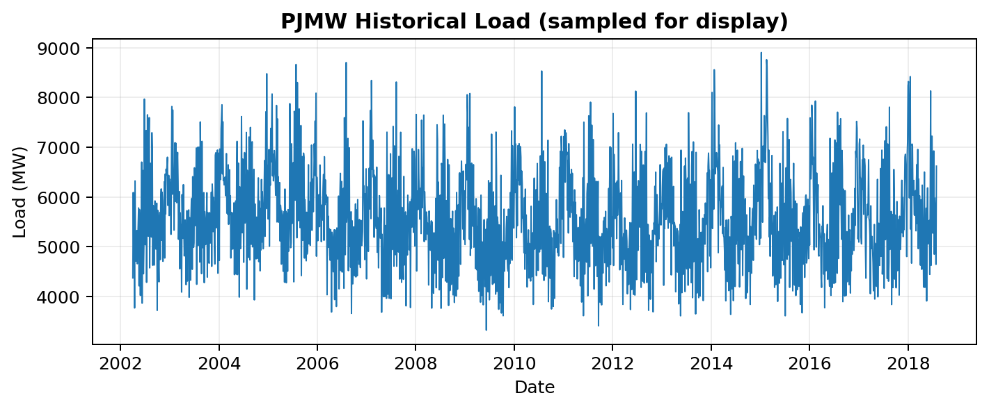
Exploratory Data Analysis (EDA)
ANALYSIS
Historical mean
5,602.4 MW
Historical range
487–9,594 MW
Median
5,530 MW
Chart uses the supplied historical data; line is sampled for readability.
P605 • PJMW Energy Consumption Forecast
05

Slide 6
Data Quality & Preprocessing
DATA
Missing values
Duplicate timestamps
Time gaps
0 missing values in the two loaded columns after parsing.
4 repeated Datetime values detected.
Most adjacent observations are 1 hour apart; some 2-hour gaps are present.
Recommended handling
• Investigate repeated timestamps before deciding how to resolve them.
• Check 2-hour intervals to identify missing hourly records.
• Preserve original data and document any interpolation or exclusions.
• The app.py description says duplicate timestamps were resolved and missing hours were filled using time-based interpolation; verify the same process in the training workflow.
P605 • PJMW Energy Consumption Forecast
06

Slide 7
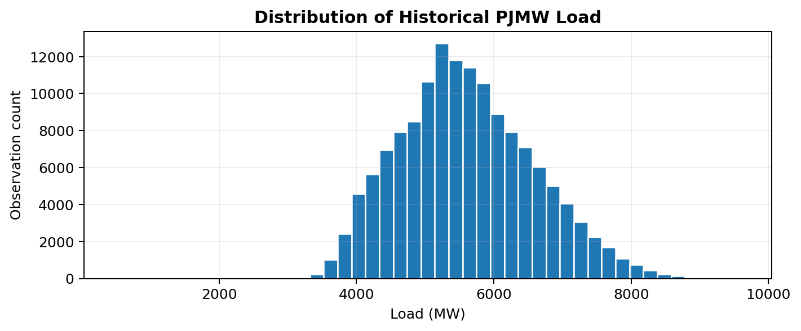
Historical Load: Descriptive Statistics
ANALYSIS
Mean
Median
Std. deviation
Min / max
5,602.4 MW
5,530 MW
979.1 MW
487 / 9,594
Minimum: 487 MW at 29 May 2003 00:00
Maximum: 9,594 MW at 20 Feb 2015 08:00
P605 • PJMW Energy Consumption Forecast
07

Slide 8
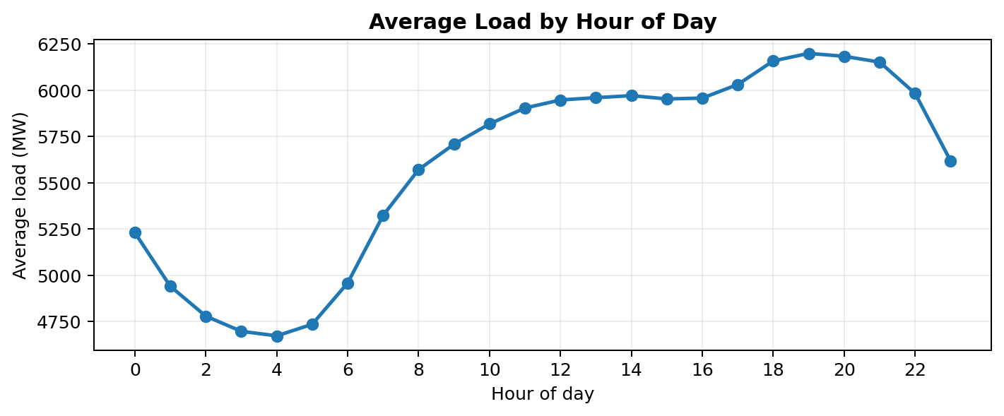
EDA: Average Load by Hour
ANALYSIS
• Highest average hour: 19:00 (6,199 MW).
• Lowest average hour: 04:00 (4,673 MW).
• The curve summarizes all available years, so it combines many seasonal and calendar conditions.
P605 • PJMW Energy Consumption Forecast
08

Slide 9
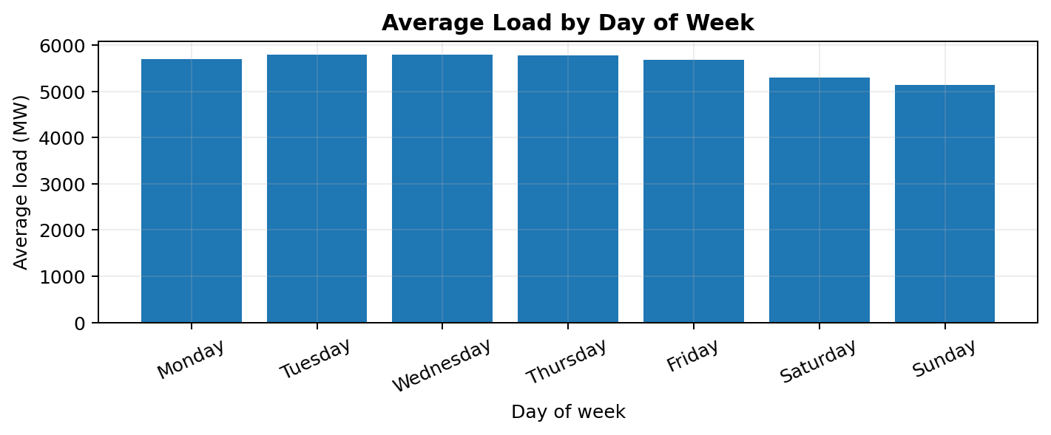
EDA: Weekday vs Weekend Pattern
ANALYSIS
Weekday average
5,754 MW
Weekend average
5,222 MW
Use these as descriptive summaries; they do not prove why the pattern occurs.
P605 • PJMW Energy Consumption Forecast
09

Slide 10
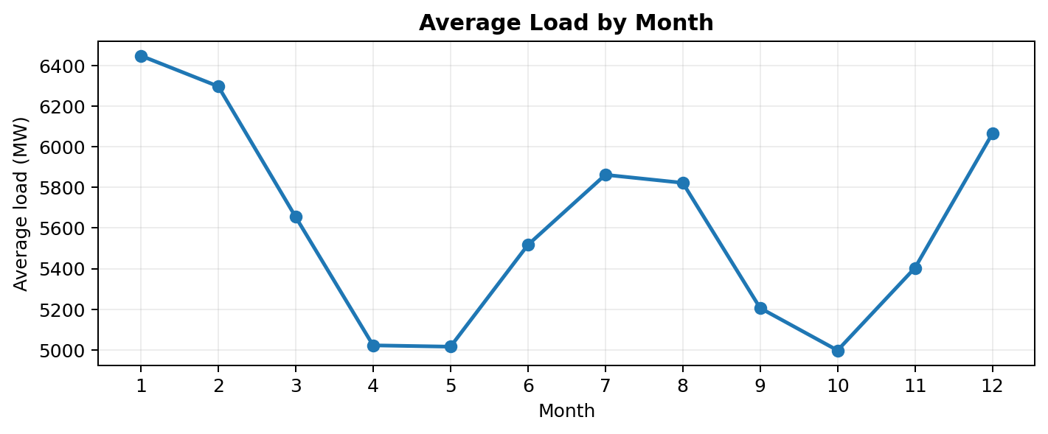
EDA: Monthly Seasonality
ANALYSIS
• Highest monthly average in the supplied series: month 1 (6,448 MW).
• Lowest monthly average in the supplied series: month 10 (4,998 MW).
• Monthly averages combine all years in the file and should be interpreted as descriptive EDA.
P605 • PJMW Energy Consumption Forecast
10

Slide 11
Forecast Dataset Details
FORECAST
Source file: 30_day_forecast.csv (Excel copy also supplied)
Forecast rows
Date range
Average forecast
30 dated predictions
03 Aug 2018 – 01 Sep 2018
5,589.5 MW
Columns: Date and Predicted_MW. This supplied output is daily-granularity (30 dates), although the historical input dataset is hourly.
The app.py code also treats each row as a date and displays a day-based horizon slider.
P605 • PJMW Energy Consumption Forecast
11

Slide 12
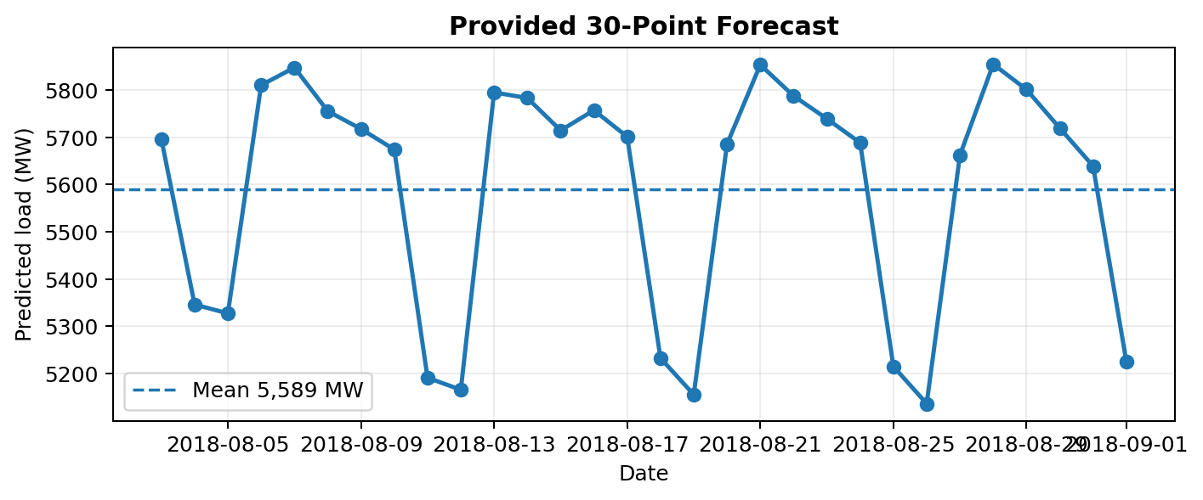
Provided 30-Day Forecast
FORECAST
Mean
5,589.5 MW
Minimum
5,136.4 MW • 26 Aug
Maximum
5,855.0 MW • 28 Aug
These are the values from the supplied forecast file; no new predictions were generated for this deck.
P605 • PJMW Energy Consumption Forecast
12

Slide 13
Feature Engineering Used by the Project
MODEL
Lag features
Rolling features
Calendar features
lag_1, lag_7, lag_14 and lag_28 appear in the feature-importance file.
rolling_mean_7, rolling_std_7 and rolling_mean_30.
dayofweek, is_weekend, month, quarter and cyclical encodings.
The app's About tab describes calendar features, lags, rolling statistics and cyclical encodings as the feature-engineering approach.
Important implementation detail: the provided forecast CSV is daily-granularity. Make sure the report and code clearly explain how hourly source data is converted to the daily forecast target.
P605 • PJMW Energy Consumption Forecast
13

Slide 14
Model Building & Benchmarking
MODEL
The app.py About tab says six models were benchmarked:
ARIMA
SARIMA
XGBoost
Listed in app.py
Listed in app.py
Listed in app.py
Random Forest
LSTM
GRU
Listed in app.py
Listed in app.py
Listed in app.py
The separate model_comparison.csv referenced by app.py was not among the supplied files, so exact benchmark scores cannot be verified or shown here.
P605 • PJMW Energy Consumption Forecast
14

Slide 15
Final Model: Random Forest
FINAL MODEL
The app.py About tab identifies Random Forest as the selected model.
Why it fits the workflow
Available evidence
Model metrics
Uses engineered lag, rolling and calendar features.
Feature-importance CSV supplied; model pickle was not uploaded.
Exact MAE / RMSE / R² / MAPE values are not available in the supplied files.
This slide reports what the app code says; the missing model-comparison file prevents independent verification of the claimed best model.
P605 • PJMW Energy Consumption Forecast
15

Slide 16
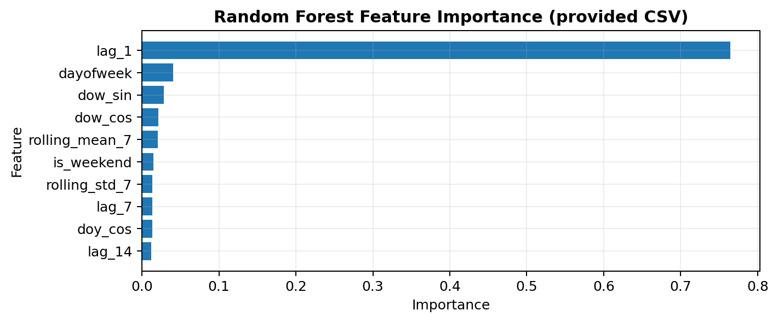
Random Forest: Feature Importance
MODEL
Top feature: lag_1
0.764 importance (76.4%)
• lag_1 dominates the provided feature-importance ranking.
• Calendar and rolling features contribute smaller shares.
• Feature importance shows model reliance, not causation.
Source: random_forest_feature_importance.csv supplied by the user.
P605 • PJMW Energy Consumption Forecast
16

Slide 17
Evaluation Strategy & Results Availability
EVALUATION
MAE
RMSE
R² / MAPE
Mean absolute error; lower is better.
Penalizes large forecast errors; lower is better.
Listed as metrics in app.py's model-comparison logic.
The app code says model comparison is based on a held-out final year and warns that ARIMA/SARIMA and other models use different forecast setups.
No numerical model-comparison table was uploaded. Do not state exact evaluation scores until model_comparison.csv or the underlying results are available.
P605 • PJMW Energy Consumption Forecast
17

Slide 18
Evaluation Caveats & Limitations
EVALUATION
• The app.py About section says reported accuracy relates to next-day predictions on daily average demand.
• It also notes multi-day forecasts can accumulate error and weather data is not used.
• The app code says some models use the previous day's actual value, while ARIMA/SARIMA forecast the test year in one go; these approaches are not directly comparable.
• A fair final comparison should use the same test dates, target granularity and forecast horizon.
This distinction matters when explaining model performance during the viva.
P605 • PJMW Energy Consumption Forecast
18

Slide 19
Forecast Application: Features from app.py
APPLICATION
Forecast tab
Model comparison
Insights tab
Line / bar chart, peak marker, values table and CSV download.
Metric selector, model chart and comparison table (requires model_comparison.csv).
Weekday averages, day-over-day change and feature importance.
Built with Streamlit, Pandas, NumPy, Plotly and joblib; app.py describes a dark animated dashboard.
Required files referenced by app.py include 30_day_forecast.csv and model_comparison.csv. The latter was not supplied in this upload set.
P605 • PJMW Energy Consumption Forecast
19

Slide 20
Screenshot of the App Page
APPLICATION
⚡ CONTROLS
PJM Energy Consumption Forecasting
Random Forest model • PJM West
Forecast horizon
Chart type
Highlight weekends
Animated reveal
PEAK
LOWEST
AVERAGE
FORECAST ROWS
5,855 MW
5,136 MW
5,589 MW
30
Forecast • Model comparison • Insights • About
Conceptual slide assembled from app.py layout and supplied forecast data; it is not a direct screenshot of a running Streamlit session.
P605 • PJMW Energy Consumption Forecast
20

Slide 21
System Architecture
IMPLEMENTATION
Historical PJMW
Excel
Cleaning &
EDA
Features +
Random Forest
Forecast CSV
Streamlit App
The supplied app is a Streamlit front end. Training pipeline/model artifact files are not all present in the upload set.
P605 • PJMW Energy Consumption Forecast
21

Slide 22
Challenges Faced During the Project
REFLECTION
01
Data quality
4 duplicate timestamps and some 2-hour gaps need review.
02
Time granularity
Hourly historical data is paired with a 30-row daily forecast file.
03
Model validation
Model-comparison CSV and serialized Random Forest model were not included.
04
Forecast horizon
Multi-day errors can accumulate; app notes no weather data is used.
05
Application dependencies
app.py expects supporting files to be placed in the same folder.
Add any additional issues your team encountered and how you resolved them.
P605 • PJMW Energy Consumption Forecast
22

Slide 23
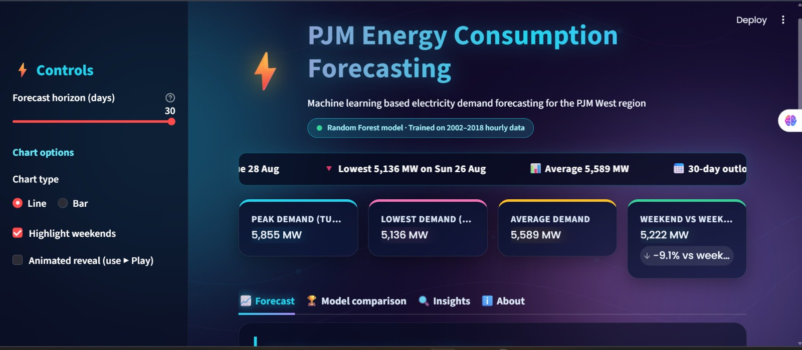
Screenshot of the App Page
Actual screenshot of the PJM Energy Consumption Forecasting application.
P605 • PJMW Energy Consumption Forecast
23

Slide 24
THANK YOU
Thank you for your time and attention.
Questions & Discussion
Team 7 • Mentor: Abisheka Kavuri

